Slide 1

MINOR PROJECT (ICCI-300)
DR. B.R. AMBEDKAR NATIONAL INSTITUTE OF TECHNOLOGY, JALANDHAR
DEPARTMENT OF INSTRUMENTATION AND CONTROL ENGINEERING
GSF MONITORING SYSTEM
SUBMITTED BY:
MUSKAN (18106042)
PARTH SHINH (18106052)
PRABHLEEN KAUR(18106054)
UNDER THE GUIDANCE OF:
DR. AFZAL SIKANDER
(ASSISTANT PROFESSOR, ICE)

Slide 2
INTRODUCTION
G stands for Garbage
S stands for Sewage Monitoring System
F stands for Fire
This project GSF Monitoring system is a very innovative system which will help to keep the cities clean and safe by informing user via message (or a reminder) and shows the status to the user who is monitoring it.
The proposed system is low cost, less maintenance, long life and real time system, which update the municipal officer by text message

Slide 3
LITERATURE survey
For G- Monitoring, In solid waste bin monitoring system garbage bin is set at the public place and a Camera is set at the garbage bin location.
For S- Monitoring, In sewage monitoring system area to be cleaned is put under video screening to monitor regularly.
For F- Monitoring, Ahmed Imtiaj studied the problems faced by factory workers in times when fire breaks out. They proposed a system which is capable of detecting fire and providing information about the area of fire.
REFERENCES:
https://www.ijireeice.com/upload/2017/january-17/IJIREEICE%2015.pdf
http://www.ijstr.org/final-print/feb2020/Smart-Sewage-Alert-System-For- Workers-In-Real-time-Applications-Using-Iot.pdf
http://www.acadpubl.eu/hub/2018-118-21/articles/21e/62.pdf

Slide 4
PROBLEM STATEMENT
As we are expecting a clean and green environment everywhere whether we are live in that area or just roam around, we all still want it clean.
There are so many bins all around the campus but there is no system to check their cleansing properly.
There is no system to detect sewage leakage problem.
As we want our campus to be clean and safe, we took this real world problem that will resolve many of the issues.

Slide 5
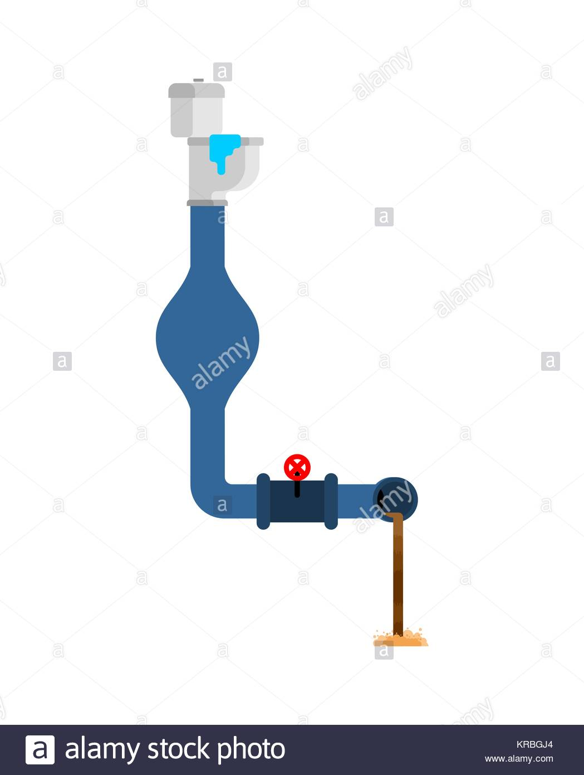
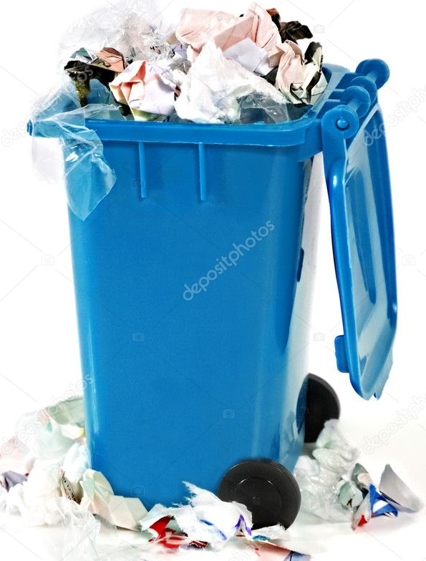
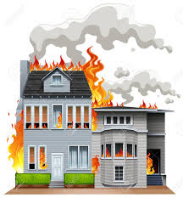
BRIEF IDEA OF PROPOSED SOLUTION
Water Level Sensor records height of water in sewage duct
Ultrasonic Sensor records distance of height of Garbage bin
Live data send to microcontroller
After processing Send to App
Alert signal if something in danger zone
Flame Sensor records emission of gases

Slide 6
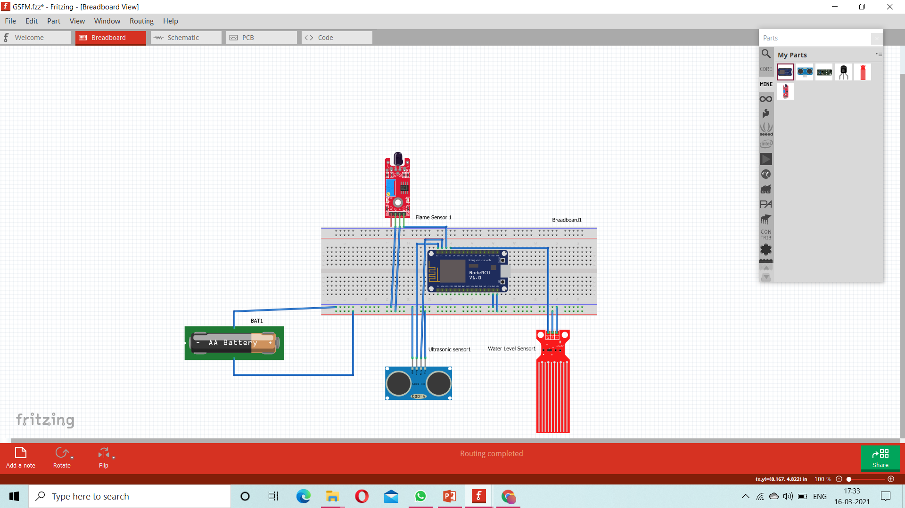
SCHEMATIC CIRCUIT DIAGRAM

Slide 7
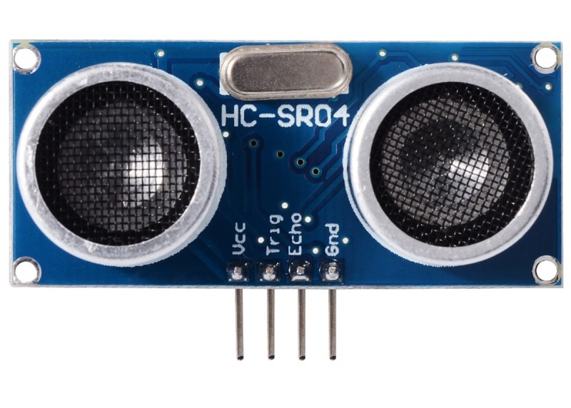
GARBAGE OVERFLOW DETECTION
Sensor required is HC SRO4 ULTRASONIC SENSOR
It measure distance by using ultrasonic waves. The sensor heads emits an ultrasonic wave and receives the wave reflected back from the target.
Thus, it measures the distance to the target by measuring the time between the emission and reception.
Features of Ultrasonic sensor are:
Compact and light weight
For ultrasonic sensing, most widely used range is 40 to 70KHz
Operating voltage is 5V DC
Operating current is 15mA
Range is 2cm – 4m
Measuring angle is 15 degree
Power consumption of 20mA

Slide 8
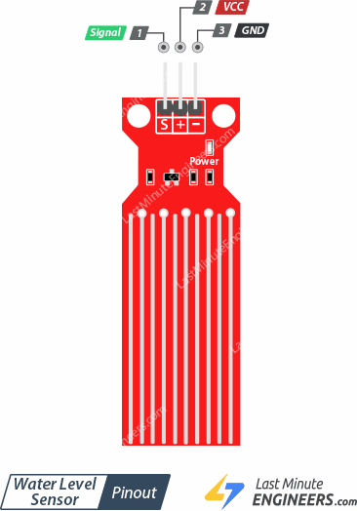
SEWAGE LEAKAGE DETECTION
Sensor Required is WATER LEVEL DEPTH DETECTION SENSOR
It work by series of exposed parallel conductors, together act as variable resistor whose resistance varies according to water level.
The resistance is inversely proportional to height of water.
Features of Water Level Sensor are:
Operating Voltage is DC- 5V
Operating Current is less than 20mA
It is analog type sensor
Detection Area is 40mm * 16mm
Operating temperature lies between (10 degree – 30 degree) Celsius
Cost effective
Not conductivity based.
Compact size, and easy to mount.

Slide 9
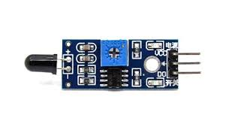
FIRE DETECTION
Sensor required is INFRARED FLAME SENSOR
It is a kind of detector which is mainly designed for detecting as well as responding to the occurrence of a fire or flame.
This sensor uses the infrared flame flash method, which allows the sensor to work through a coating of oil, dust, water vapor.
Features of Flame Sensor:
High Photo Sensitivity
Fast Response Time
Sensitivity adjustable
Operating voltage is 3.3v - 5v
Detection range is 60 degrees
Detect light sources of wavelength 760nm – 1100nm
On-board LM393 chip
Dimension is 3.2cm x 1.4cm

Slide 10
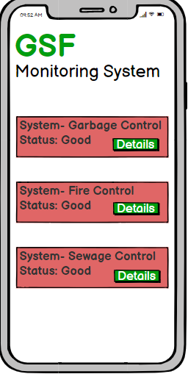
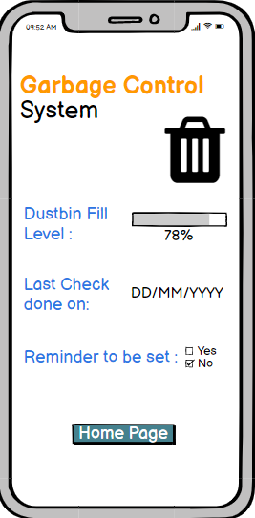
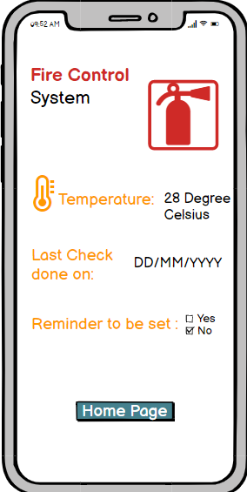
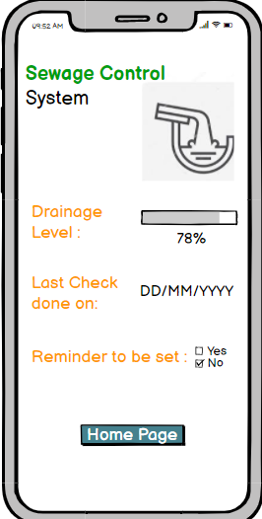
WIREFRAME OF the app
On clicking on the details button
Home Page

Slide 11
BENEFITS
One click monitoring of garbage, sewage and fire on app.
It is an Innovative system to keep the institute as well as cities clean.
It saves lives by warning building occupants of emergencies so they can get out of danger.
Immediate monitoring of problems and corrective action can be taken on time.
Easy and Affordable solution
The system will able to monitor all these things in real-time scenario which will allow us to take proper actions of the particular problem in drainage system.

Slide 12
APPLICATIONS
This system monitors the garbage bins and informs about the level of garbage collected in the garbage bins via a message from the app.
This app can be used on Institute level ,in homes as well as on company level .
In this system, level of drainage is continuously monitored.
By doing this we can able to take particular action on the problems as we will receive the early alerts of blockage as well as increase of levels in drainage systems.

Slide 13
PROJECT BUDGET
HC SR04 Ultrasonic sensor : 145Rs
Water level depth detection sensor: 100Rs
Infrared Flame sensor: 110Rs
Node MCU Esp8266 : 350Rs
Breadboard: 150RS
Jumper Wires: 120Rs
Battery(12V): 50Rs
Total Rupees: 1025Rs

Slide 14
TIMELINE
Target
Initial State:-
Researched for the current existing problems
Transient state:-Designing a virtual circuit and process control and other circuitry elements.
Final State:-Creating a Android based application for receiving the data from sensor and work accordingly.

Slide 15
CONCLUSION
Thus, GSF Monitoring system is used to monitor real time issues related to garbage, sewage and Fire.
It is a cost effective and user friendly solution.
Users can monitor all problems in one app.
Further, this system can be extended to city level or state level.

Slide 16
THANK YOU

